Slide 1





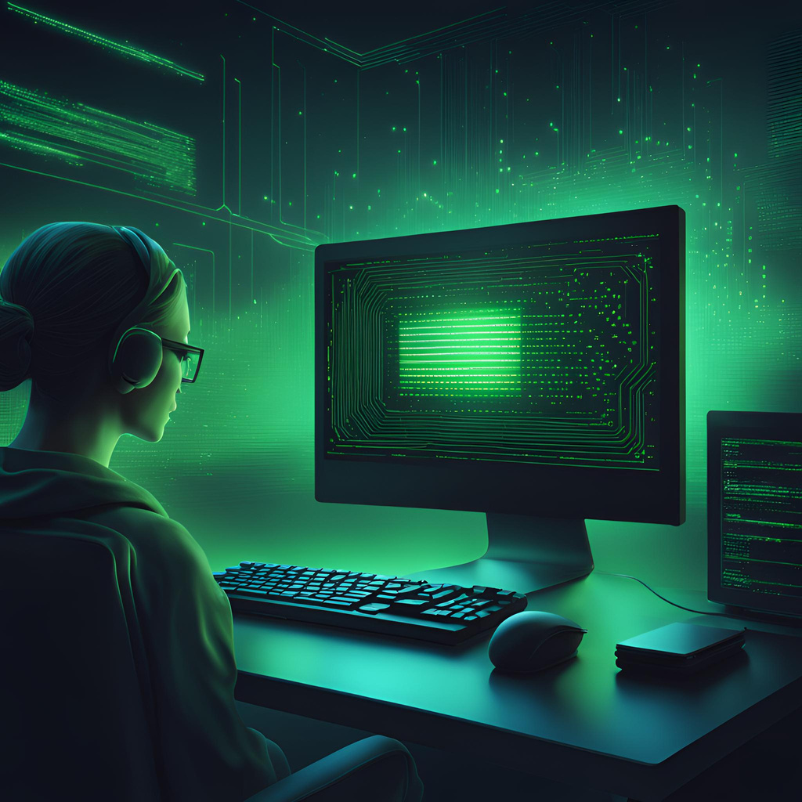






PhishNet
PHISHNET
ANTIVIRUS
Gianmarco Bonventre, AJ Whitman,
Aarshia Hukmani, Julia Pallazola
Due Date: December 3rd, 2024

Slide 2



Problem
Users often do not consider the potential risks when they download files to their system.
Users download files from unsafe sources (pirating a movie or textbook)
Viruses are often not seen and are embedded in files and directories that users do not think to check

Slide 3


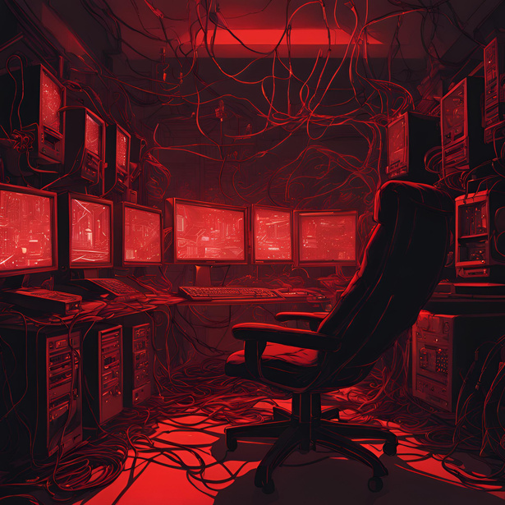
Background- Current Solutions
Anti-Virus Software
Services like McAfee will scan your system for viruses but usually require monthly/yearly payments.
Only Downloading from Trusted Sources
While this may be the best solution, even websites that a user may think are trustworthy could have false URLs or misleading content.
Anti-virus Web Extensions
Services like Guardio come as an extension to your current browser. While it seems that these may be handy in first-line defense, these extensions can slow down your browser experience, will ONLY scan the browser it is downloaded for, and may collect your data!

Slide 4


Our Solution- PhishNet
Manual/Automatic Virus Scanning
Users can perform a scan whenever they would like as long as no other scan is running. Users can schedule scans for when they are away or while using the system.
By taking advantage of the open-source ClamAV antivirus backend, we created a free, easy-to-use Linux application where users can scan for viruses, have the most up-to-date software, and will not cause latency among other tasks.
Free Application
PhishNet uses ClamAV, a free, open-source anti-virus engine for its backend functions. Therefore, it is a free and free-to-use application.
Lightweight Application
ClamAV is a lightweight virus scanner, meaning that PhishNet will be able to run smoothly when other applications are open or tasks are being run.
Always Up-to-Date
Through manual and automatic updates, PhishNet will always have the latest virus bytecodes therefore, the user’s system will always be the most protected.

Slide 5





Project Goals
Keep Systems Safe
Supply a User-Friendly Interface
User-Chosen Scans & Scheduled Scans
Allow the user to update their system when the backend database is updated with new virus bytecodes.
Having the most updated bytecodes means that the user will have the most accurate scans.
We created a simple user interface that even someone new to technology could use.
Users will be able to choose from 3 manual scan types: System Scan, Quick Scan, and Custom Scan.
Users can schedule a System or Quick Scan to be completed daily, weekly, or monthly at their preferred time.

Slide 6
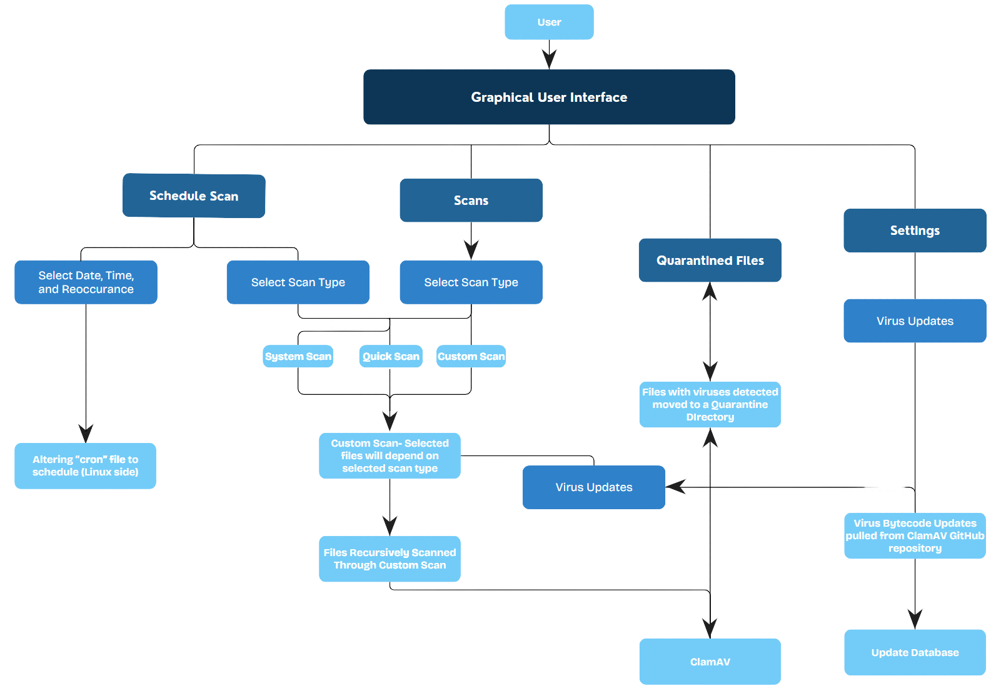
Project Design

Slide 7
Methods
Featuring Custom Scan:
The Scanning Algorithm
All scan types go through Custom Scan, the scan type chosen signifies what files or directories will be scanned.
Custom Scan: The user chooses files and directories to scan
System Scan: All files and directories will be chosen by the system
Quick Scan: The most important files and directories will be chosen by the system
Initialize ClamAV
Set scan path (file path)
Show amount of files scanned
Choose the type of scan
Initialize virus database
Scan finishes & reports directory or a file
End database
Give scan results
Log infected file with threat name, shows where the file was
Constructs new destination path
Moves the file(s) into quarantine
Generate report to be available in History

Slide 8










Project Implementation
Early October
Late October
November
December
Backend & Frontend Initialization
Frontend & Backend Development
Frontend Development
Integration & Testing
Main Tasks:
GUI Design - Julia
GUI Development - Aarshia
GUI Component Testing- Aarshia
Main Tasks:
Integrating front end and back end- All
Testing user initiated functions
Main Tasks:
Initializing ClamAV- All (MAJOR CHALLENGE)
UI Design- Julia
Initializing frontend creation- Aarshia & Julia
Main Tasks:
Create working pages without backend functionality

Slide 9

Testing Strategy
Test Data
Infected ICAR files. User inputs.
Test Methods
Existing ClamAV test files were used to test all scanning types. Schedule scan was manually tested by inputting a date and time.
Test Results
PhishNet is consistent in correctly identifying virus bytecodes within the test files.

Slide 10


Risks & Changes
Risks
Changes
Could not download ClamAV on Windows 10
Switched the project to Ubuntu 20.04
Overhauled original schedule and redistributed workload
2 weeks behind schedule
Accidentally deleting or overriding GitHub files
Reuploading files more carefully

Slide 11

Team Experience
The Groups Tasks:
Gianmarco- Backend development, database initialization, Integration
Aarshia- GUI development and Integration
AJ- Backend development and Integration
Julia- GUI Design, Document updates, Research, and Integration
Meetings- Met in person on Monday nights bi-weekly until the last 2 Mondays where we met every week
Software Management- GitHub; version control using branches

Slide 12

Conclusion
When submitting the project deliverable, we were able to achieve:
Three working scan types: Quick Scan, System Scan, and Custom Scan
The ability to schedule scans for a time and frequency
The quarantining of infected files through a directory
Reports generated at the end of each scan that are available for the user to view
What we learned:
Working with open-source code is tricky- lots of developer problems
Never assume your first idea will work, and always plan for failure
Trying to manage code through GitHub is difficult with a group and files will get deleted or overwritten
Do not expect all existing code to have useful or detailed documentation

Slide 13

THANK YOU!
ONTO THE DEMO

